Slide 1
Hidden slide
Teachers are cordially requested to follow the instructions below the page.
Notes:
This page is not for the students but for the teachers.

Slide 2
You are most welcome to the world of-
HHR Multimedia presentation.
Notes:
Welcome slide.

Slide 3
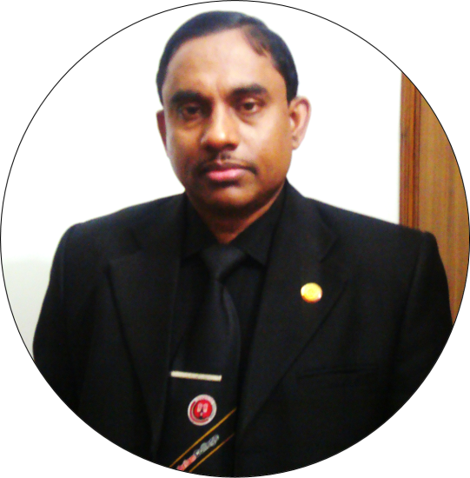
Introduction
Md Hasan Hafizur Rahman
Senior Lecturer &
Head of the Department (English)
Cambrian School & College
Campus-5, Dhaka.
Class-VIII
English First paper
Notes:
Introduction.

Slide 4
Enjoy a video and try to guess something.
Have you guessed anything different from the previous lesson about taking off?
Is it faster than the previous aircraft?
Let us see from
our today’s lesson.
Notes:
Teacher may observe the slide first then go ahead accordingly.

Slide 5
Our Today’s Lesson is-
Future Aircraft
Unit-9, Lesson- 5

Slide 6
Aims of the lesson-
By the end of the lesson, students will be able to-
ask and answer questions
read and understand text materials
participate in a short dialogue
write answers to the questions
write short paragraphs
Notes:
Both speaking, listening, reading & writing skills will be focused in this lesson.

Slide 7
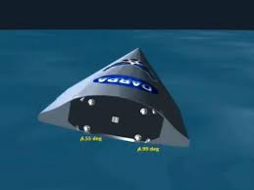
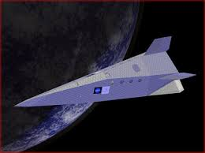
A Look at the pictures and say what they are. Discuss with your partner.
Notes:
Teacher may ask the students to discuss the picture with their partners to lead the topic. To avid word meaning section teacher may click right arrow.

Slide 8
Key words
Notes:
To skip key word option teacher may use hyperlink of page number 7. If time may be managed, he can show the word first, then he may ask the meaning of the word, then he may show the meaning and making sentence.

Slide 9
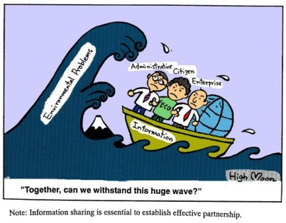
withstand
survive, tolerate
Notes:
Teacher may show the word first, then he may ask the meaning of the word, then he may show the meaning and making sentence.

Slide 10
Space
area, place, distance
No one can cross the space of the sky.
Notes:
Same as above.

Slide 11
Bade
See off
Notes:
Same as above.

Slide 12
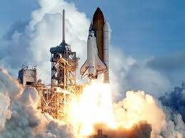
Launch
Take off/departure
Notes:
Same as above.

Slide 13
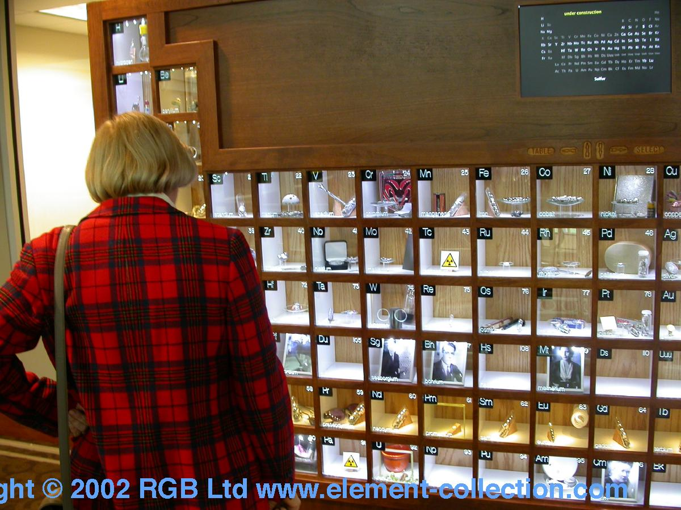
display
show, appearance
Notes:
Same as above.

Slide 14
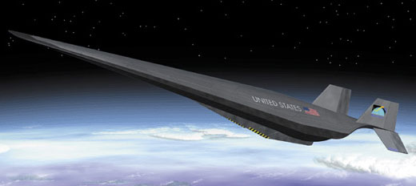
Hypersonic
High speed/fastest
Notes:
Same as above.

Slide 15
research
investigate, explore
Notes:
Same as above.

Slide 16
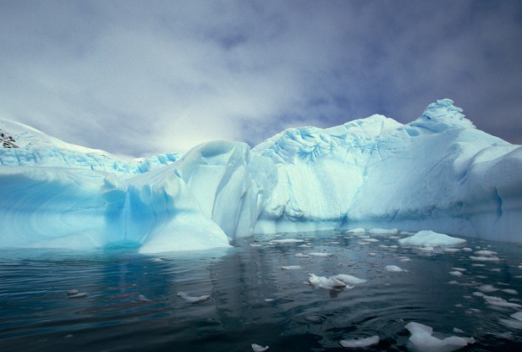
Melting
liquefying, dissolving
Notes:
Same as above.

Slide 17
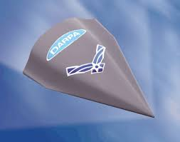
Characteristics of-
Hypersonic Technology Vehicle-2
(Falcon HTV-2)
Falcon HTV-2
Mankind’s dreams aircraft in future.
The fastest plane ever built.
London-Sydney (less than 1 hour.)
Withstand temperature 2000 C.
This temperature is hotter than-
Notes:
Teacher may show and narrate the slide one after another as he likes.

Slide 18
2000 degree Celsius
Steel melting temperature
(2000 degree Celsius)
Notes:
Dangerous experience.

Slide 19
1. It was born in 2003.
About HTV-2
2. It was a part of US military project.
3. Its target is to reach any part of the world in less than 1 hour.
4. Its aim is to use any purpose like civil or army.
Hypersonic Technology
Vehicle - 2
5. It is already tested in computer model.
Notes:
Teacher may show and narrate the slide one after another as he likes.

Slide 20
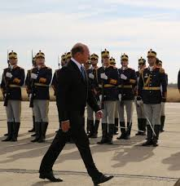
US Defense Agency
will launch the Falcon HTV-2.
But how?
Notes:
Teacher may show and narrate the slide one after another as he likes.

Slide 21
First, they will set it on the back of a rocket like the picture above.
Notes:
Teacher may go like previous.

Slide 22
Then they will launch both into the space from an Air Force Base.
Notes:
Same as above.

Slide 23
The engineers will detach the plane from the rocket. All these will be guided and monitored by the engineers in its flight.
The plane would fly in hypersonic speeds of 13,000 mp/h. This speed is about 20 times the speed of sound.
Notes:
Teacher may read the lines himself to narrate the lines.

Slide 24
Questions
1 What is HTV-2?
2 What is the speed of HTV-2?
3 Describe the steps of HTV-2 test flight.
4 Why was the HTV-2 developed?
5 Do you think that HTV-2 will be ‘mankind’s dream aircraft’? Why do you think so?
Notes:
Teacher may conduct this slide orally or written.

Slide 25
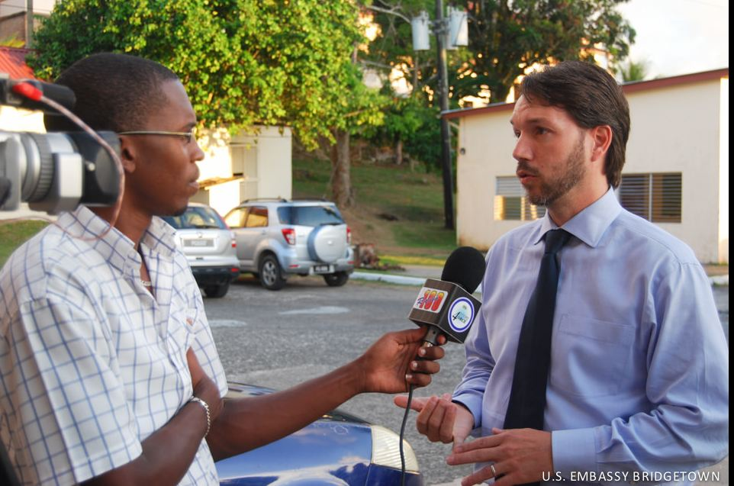
C Imagine you are a TV reporter. You have come to interview the chief engineer of the HTV-2 Launch Project. What questions will you ask him/her? Design a short dialogue between yourself and the engineer, and write it. Finally act it out in pairs.
Notes:
Teacher may describe the picture to solve the question. No Bangladeshi suitable picture is found.

Slide 26
D Listen to the teacher/CD carefully and complete the following sentences with appropriate words.
U9, L5 D Listening text: 11
1 Thursday's flight will test another _________ of the aircraft.
2 The plane is made of ____ composite
materials.
3 The plane will fly in __________ speeds.
4 In the flight, the body _______ of the plane could reach 2,000 degree Celsius.
5 _____will melt at 2000 degree Celsius.
operation
some
supersonic
portion
Steel
Notes:
Teacher may ask the students to fill in the blank. Answer may vary. At last he may show the answers to check if they are correct or not.

Slide 27
The following passage is based on the information in section B. Read the text in B. Complete the following sentences with will/ would, can/could/could not.
could not
Even Concorde ________ fly as fast as Falcone HTV-2. The news report says: the US defense Agency _____launch the Falcon Hypersonic Technology Vehicle-2 into space. Scientist expect that the Falcon HTV-2_______ fly at 13,000 miles per hour. The US military wishes that the Falcon ____ bomb any part of the world in less than an hour in the future. Engineers plan that they_____ set the Falcon on the back of a rocket to launch it into the distant space.
will
would
can
will
Notes:
Teacher may ask to fill in the gap. Then he may show the answer to check if they are correct or not.

Slide 28
Home Work
F Have you ever dreamt of flying? If yes, write about your dream. If no, try to imagine you are flying in a plane. Write about your experience.
If you fly westward in a supersonic plane such as Concorde, you will land several hours before you took off. Can you explain how?
Notes:
If time does not cover, this may be the home work for next class.

Slide 29
Thank you
Notes:
Thank you slide.

Slide 30
Acknowledgement
We would like to express our cordial gratitude to the Ministry of Education, Directorate of Secondary & Higher Education, NCTB, A2i and the panel of honorable editors ( Md. Jahangir Hasan, Assistant Professor (English) TTC, Rangpur, Ranjit Poddar, Associate Professor (English) TTC, Dhaka, and Urmila Khaled, Assistant Professor (English) TTC, Dhaka, to enrich the contents.

